Slide 1

Name : Pesala Venkata Akash SkillsBuild Email ID : akashpesala165@gmail.com College Name : Lakireddy Balireddy College of Engineering College State : Mylavaram Internship Domain : Artificial intelligence Internship Start and End Date : 09/06/2023 and 03/07/2023
Student Details

Slide 2

LOAN STATUS PREDICTION

Slide 3



PROBLEM STATEMENT
Dream housing finance company deals in all home loans. They have a presence across all urban, semi-urban and rural areas. Customers first apply for a home loan after that company validates the customer’s eligibility for a loan. The company wants to automate the loan eligibility process (real-time) based on customer detail provided while filling out the online application form. These details are gender, marital status, education, number of dependents, income, loan amount, credit history, and others. To automate this process, they have given a problem to identify the customer segments, that are eligible for loan amounts so that they can specifically target these customers.

Slide 4
INTRODUCTION
It is a classification problem where we have to predict whether a loan would be approved or not. In these kinds of problems, we have to predict discrete values based on a given set of independent variables (s). Classification can be of two types:
Binary Classification :- In this, we have to predict either of the two given classes. For example: classifying the “gender” as male or female, predicting the “result” as to win or loss, etc.
MultiClass Classification :- Here we have to classify the data into three or more classes. For example: classifying a “movie’s genre” as comedy, action, or romantic, classifying “fruits” like oranges, apples, pears, etc.

Slide 5
LIBRARIES
Numpy
Pandas
Seaborn
Sklearn
MODULES
SUPPORT VECTOR MACHINE

Slide 6
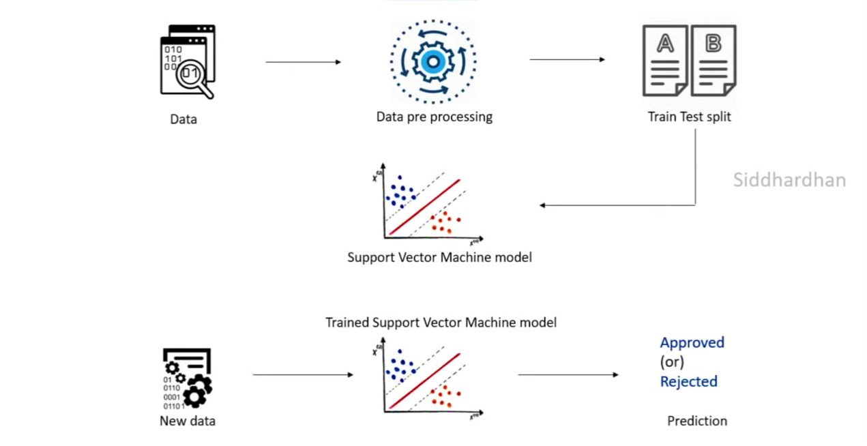
WORK FLOW

Slide 7
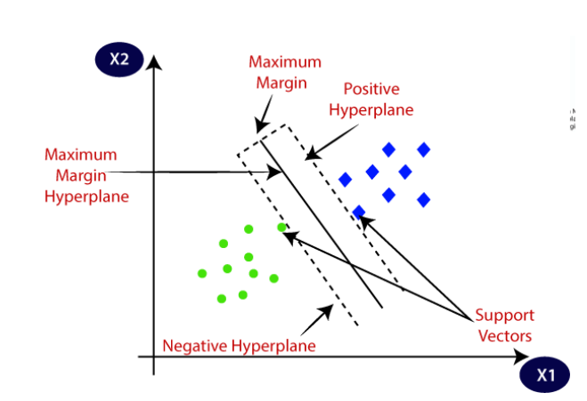
SUPPORT VECTOR MACHINE
Support vector machine or SVM is one of the most popular supervised learning algorithms, which is used for classification as well as regression problems.
The goal of the svm algorithm is to create the best line or decision boundary that can segregate ndimensional space into classes so that we can easily put the new data point in the correct category in the future. This best decision boundary is called a hyperplane

Slide 8
TYPES OF SVM
Two types of SVM :
Linear SVM
Non linear SVM

Slide 9
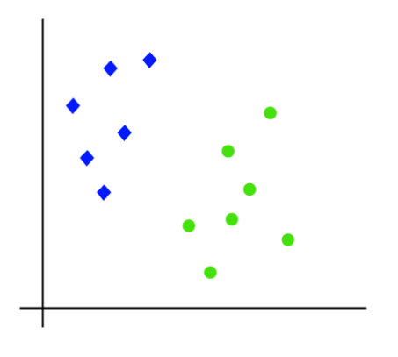
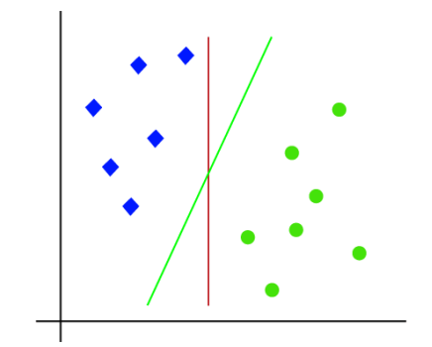
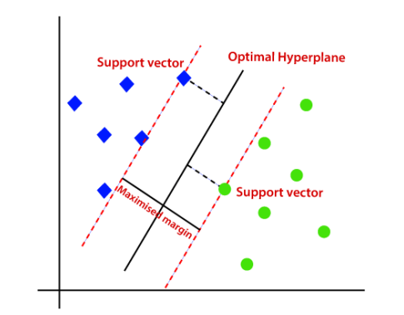
Linear SVM
The working of the SVM algorithm can be understood by using an example. Suppose we have a dataset that has two tags (green and blue), and the dataset has two features x1 and x2. We want a classifier that can classify the pair(x1, x2)of coordinates in either green or blue. Consider the below image:
So as it is 2-d space so by just using a straight line, we can easily separate these two classes. But there can be multiple lines that can separate these classes. Consider the below image:
Hence, the SVM algorithm helps to find the best line or decision boundary; this best boundary or region is called as a hyperplane. SVM algorithm finds the closest point of the lines from both the classes. These points are called support vectors. The distance between the vectors and the hyperplane is called as margin. And the goal of SVM is to maximize this margin. The hyperplane with maximum margin is called the optimal hyperplane.

Slide 10
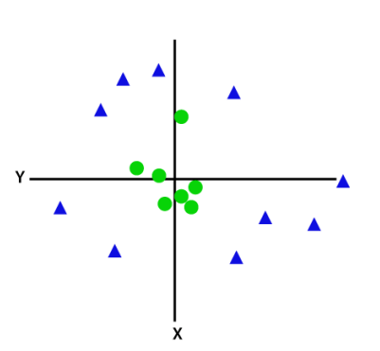
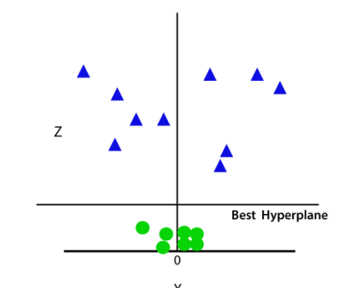
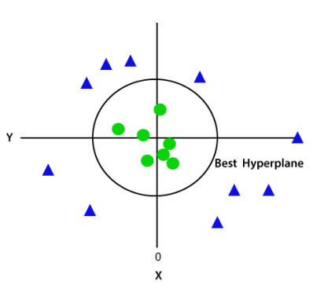
NON LINEAR SVM
If data is linearly arranged, then we can separate it by using a straight line, but for non-linear data, we cannot draw a single straight line. Consider the below image: so to separate these data points, we need to add one more dimension. For linear data, we have used two dimensions x and y, so for non-linear data, we will add a third dimension z. It can be calculated as:
z=x2 +y2
So now, SVM will divide the datasets into classes in the following way. Consider the below image:
Since we are in 3-d Space, hence it is looking like a plane parallel to the x-axis. If we convert it in 2d space with z=1, then it will become as:

Slide 11

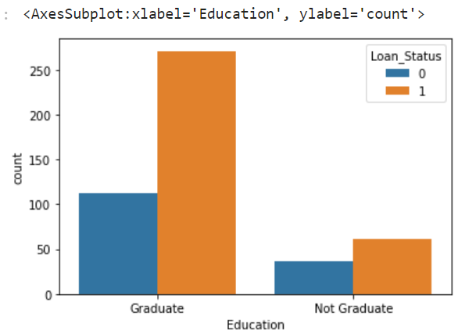
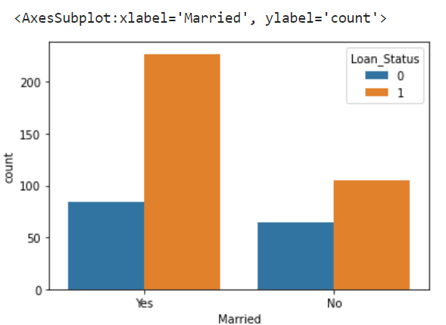
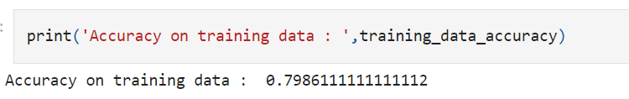
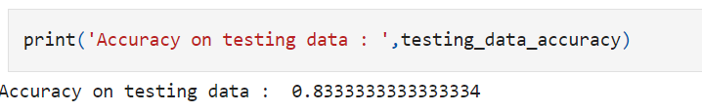
Results

Slide 12
Links
Github Links
https://github.com/akash-pesala/akash-Tutorial/blob/main/LOAN%20STATUS%20PREDICTIONS.pptx

Slide 13
THANK YOU

